Slide 1
RMIT at PAN-CLEF 2020: Profiling Fake News Spreaders on Twitter
Xinhuan Duan, Elham Naghizade,
Damiano Spina, Xiuzhen (Jenny) Zhang
RMIT Research Centre for Information Discovery and Data Analytics (CIDDA)
Notes:
Instructions
To create em dash above headline Same size and weight as the headline and set using a soft return. PC: Em dash (—): Alt+Ctrl+ - (minus) Mac: Em dash (—): Shift+Alt/Option+hyphen

Slide 2

Introduction
Widespread fake news adverse effect on economy, democracy and public health.
PAN 2020 challenge on author profiling.
We approach the challenge of profiling fake news spreaders through extracting linguistic and sentiment features only from users’ tweets.

Slide 3
Proposed Approach

Slide 4
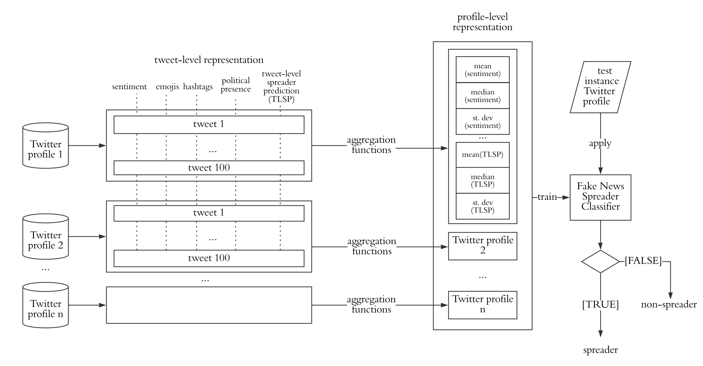
Architecture of proposed approach
Tweet-level
Profile-level

Slide 5
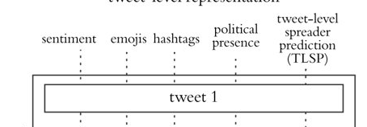
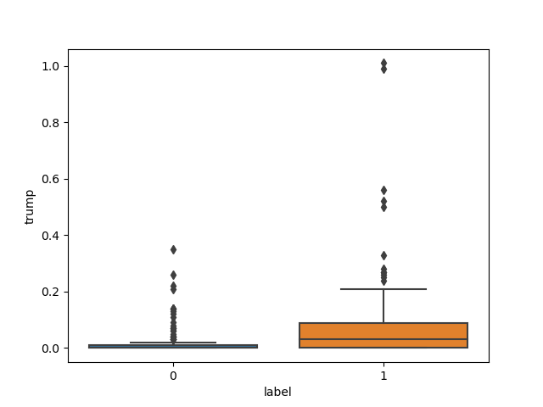
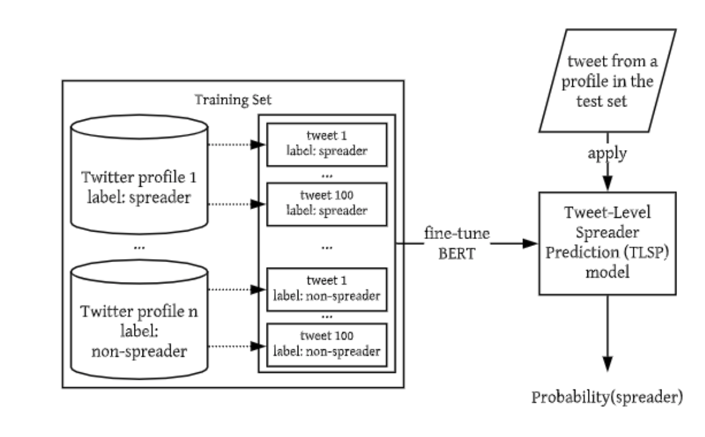
Tweet-Level Representation
Tweet-Level Spreader Prediction
Sentiment (-1 to 1)
Presence of emojis
Presence of #Hashtags
Political presence
TLSP (Tweet-Level Spreader Prediction)

Slide 6
Profile-Level Classification
Profile-level
Aggregation Functions
Mean
Median
Standard Deviation
Binary Classification (e.g., SVM)

Slide 7
Results

Slide 8
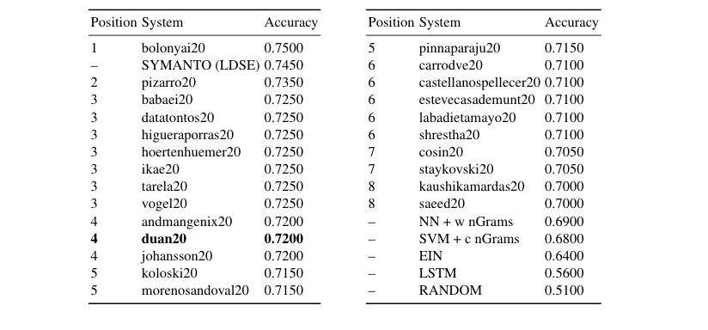
Public Results (English)
Preliminary Results
10-fold cross validation
Accuracy: 0.700
Precision: 0.714, Recall: 0. 691

Slide 9
Future Work

Slide 10
Future work
Modeling emotions in addition to sentiment.
Modeling political bias(presence orientation is more).
Understanding the impact of TLSP.
Address the task in other languages (e.g., Spanish).

Slide 11
Thank you！ 谢谢！ ¡Gracias！ ευχαριστώ！
Xinhuan Duan, RMIT University
s3713321@student.rmit.edu.au
Code: http://github.com/rmit-ir/pan2020-rmit
Notes:
Instructions
To create em dash above headline Same size and weight as the headline and set using a soft return. PC: Em dash (—): Alt+Ctrl+ - (minus) Mac: Em dash (—): Shift+Alt/Option+hyphen

Slide 12
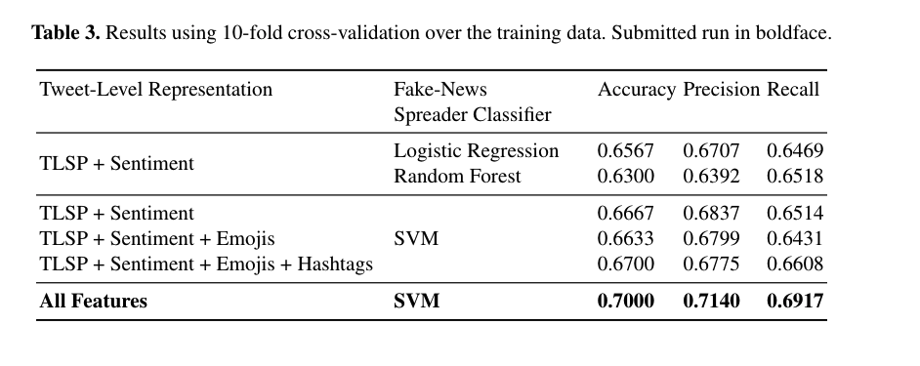
More Results

